Slide 1
How to safely embrace the Hybrid Cloud in a DevOps World?
Arnfinn Strand | Cloud Security Engineer Europe

Slide 2

WELCOME TO THE CLOUD
Notes:
Sacrificing speed and agility for security
Lateral spread of threats
Security concerns associated with moving data beyond traditional IT controls keep many organizations from fully embracing the cloud. Businesses want the ability to control their own data and keep it private all while maintaining compliance with regulatory mandates.
Advanced protections against cyber threats – traditional on-premise solutions provide a rich set of application-level security and advanced malware protections, but similar tools are not part of the cloud security arsenal. Cloud providers utilize a shared responsibility security model – providing only one piece of the overall cloud security puzzle – leaving customers with a false sense of security for their cloud applications and data. Since corporate IT security doesn’t touch cloud services organizations, their cloud assets are vulnerable to the same security exploits and threats as their on premise assets.
Visibility into all traffic and threats – with more and more data extending beyond traditional corporate control, businesses are increasingly challenged to get a clear view of the workloads running in cloud environments, including any threats and other malicious activity that could be introduced and/or affecting their data residing in the cloud. What’s more, assets tagged or grouped in the cloud may not directly translate to corporate security schemas, leaving security teams guessing as to the exact extent of their attack surface and hampering their ability to mitigate risk.
Security management and enforcement – as security controls are now shared with virtual networks and cloud providers, organizations struggle to maintain a consistent security posture for their extended application workloads and data. The tools and technology used to manage legacy corporate security are quite different than the tools and technology employed by cloud providers, resulting in a lack of consistent security policies and enforcement.
Logging and reporting – toggling between multiple, disparate solutions makes getting a clear picture of network traffic and threat activity extremely difficult, especially as data and workloads migrate away from IT controlled equipment. Audits and compliance reporting are equally challenging as businesses and cloud providers utilize different tools, maintain and secure logs in different manners, and provide varying degrees of access controls for administration and reporting

Slide 3

80/20 regeln - Paretoprincipen

Slide 4

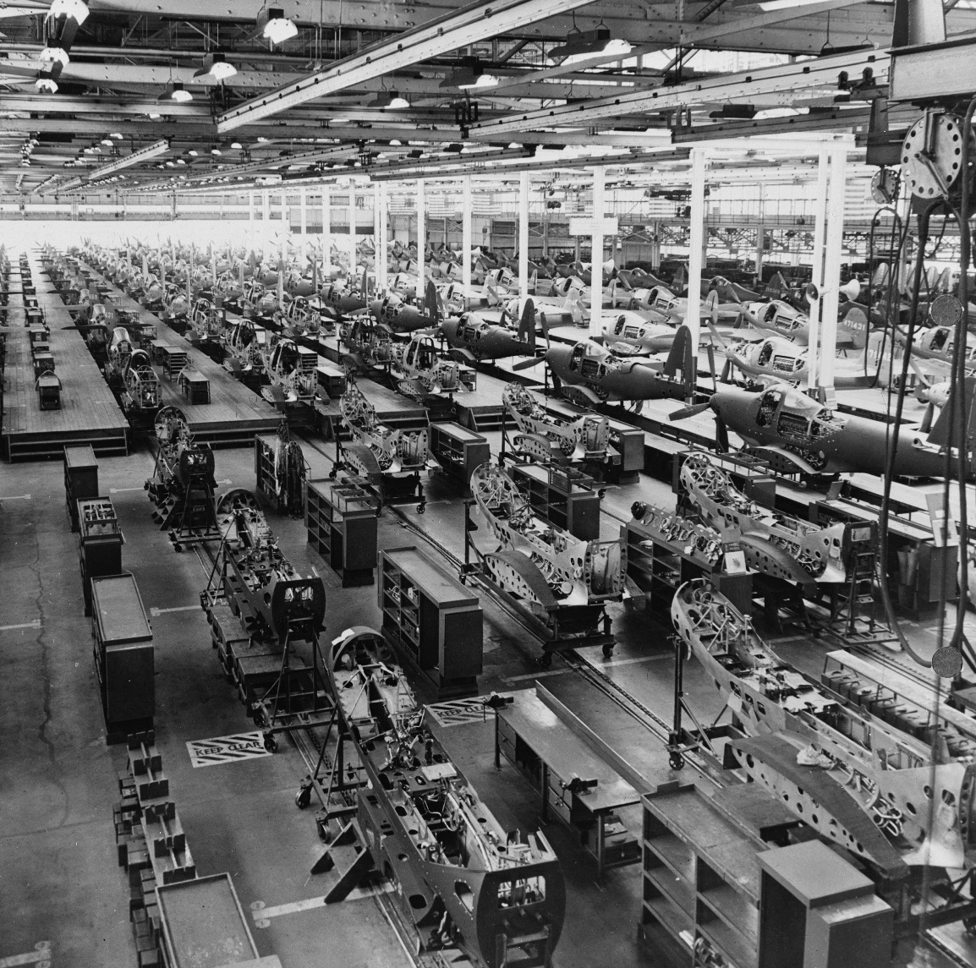
FROM STEAM TO ELECTRICITY
STEAM
ELECTRICITY
Notes:
Optional Slide
In the past we moved from steam-engine to electricity-engine..now we are moving from Virtual-Datacenter to Hybrid-Cloud. Just like with electricity engine, cloud provides more efficiency. Engineers who not learn the cloud, will find themselves out job just like the steam engineers 100 years ago.
http://andrewmcafee.org/2009/08/the-cloudy-future-of-corporate-it/
Electricity

Slide 5
FROM DATA CENTER TO CLOUD
WHAT USED TO TAKE WEEKS
TAKES MINUTES WITH CLOUD
DATA CENTER
CLOUD
Notes:
Todays’ organizations are moving their datacenter to the cloud:
OLD:
Manual operation
Perpetual licensing
Sacrificing speed and agility for security
NEW:
Automation & Orchestration
Pay as you go licensing

Slide 6
THE CLOUD IS HERE
ADOPTION
GROWTH
SECURITY
80% OF ENTERPRISES ARE COMMITTED TO CLOUD STRATEGY BY 2017
(IDC)
40% OF IT BUDGETS WILL BE CLOUD-BASED BY 2018
(Forbes)
SECURITY IS THE MAIN INHIBITOR FOR CLOUD ADOPTION
(Gartner)
Notes:
http://www.techrepublic.com/article/it-will-spend-more-than-one-third-of-its-budget-on-cloud-in-2017-says-new-report/
http://www.datamation.com/cloud-computing/cloud-will-have-a-1-trillion-impact-on-it-spending-by-2020-gartner.html
http://www.forbes.com/sites/louiscolumbus/2016/03/23/cios-are-prioritizing-big-data-analytics-cloud-computing-and-security-in-20162017-budget-cycles/#2ea8816b54f6
Security concerns associated with moving data beyond traditional IT controls keep many organizations from fully embracing the cloud. Businesses want the ability to control their own data and keep it private all while maintaining compliance with regulatory mandates.

Slide 7


WHY CLOUD?
AGILITY
Fast to react
ELASTICITY
Fast to grow
Notes:
WHAT USED TO TAKE DAYS, WITH CLOUD TAKES MINUTES
DELIVER APPLICATION IN FRACTION OF COST AND TIME
CAPEX SAVING
Hardware Consolidation
OPEX SAVING
Operation Efficiency
AGILITY
Fast Service

Slide 8


DEMO
©2017 Check Point Software Technologies Ltd.
8

Slide 9
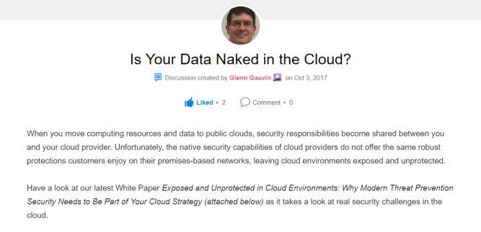
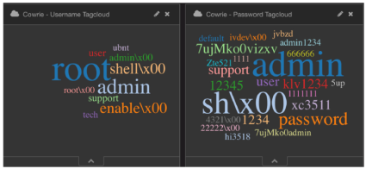
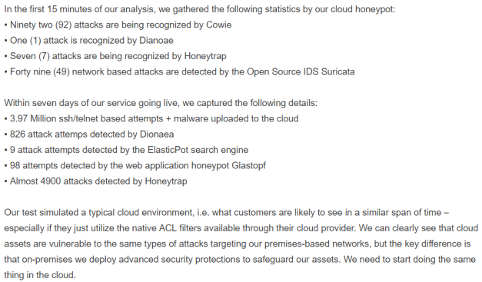
Is Your Data Naked in the Cloud?
Read the full whitepaper @
http://tiny.cc/nakedcloud

Slide 10
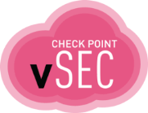
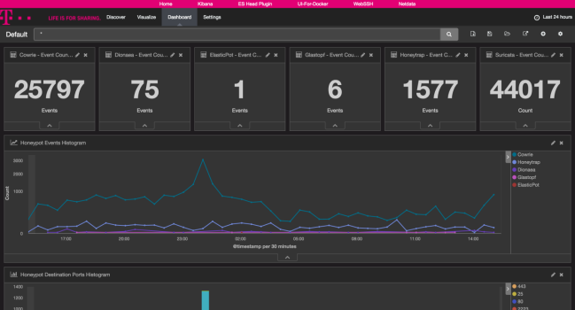
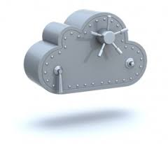
Security has to pave the way for a save trip
with the cloud – seeing is believing
Reality:
It is not about ports it’s about Applications – and there is a solution for a safe Cloud which is able to speak their language

Slide 11
Check Point Incident Response Stories
Few Stories from 2017
How much is my Cloud bill again?
Your holding my power company for ransom?
Who’s laterally moving in my cloud?
My cloud is attacking my other cloud, does that mean there is a storm coming?

Slide 12

Story #1 - How much is my cloud bill?
Major corporate hosted advertisement campaign on a public cloud
Stood up web servers globally for campaign
Configured auto scaling to ensure the infrastructure could grow
Simple web architecture which was copied from corporate prod
Deployed basic available cloud controls
Attacker found web admin vulnerability and placed bit coining and DDoS malware on web server
Infrastructure started to auto scale…..And boy did it….

Slide 13

Story #3 - Who’s moving literally in my cloud
Customer deployed in a public cloud web hosting infrastructure
Application developer required an SQL connection from cloud provider to backend database hosted within corporate environment
Request a firewall port be opened for MySQL
Corporate only deployed simple firewall and load balancer in cloud
Attacker found an SQL injection attack in app and obtained shell
Moved laterally from cloud to corporate environment
Bob’s your uncle

Slide 14
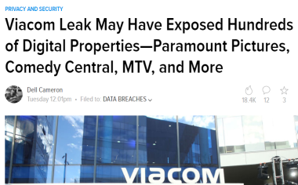
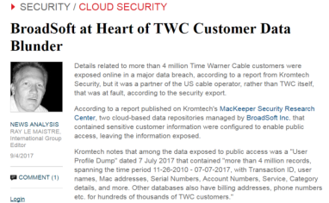
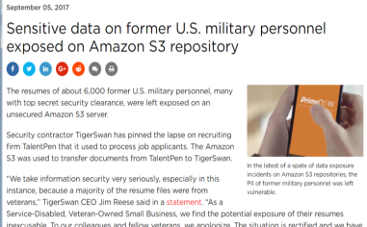
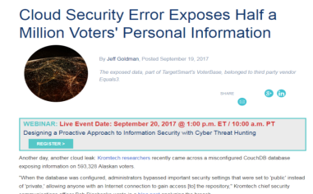
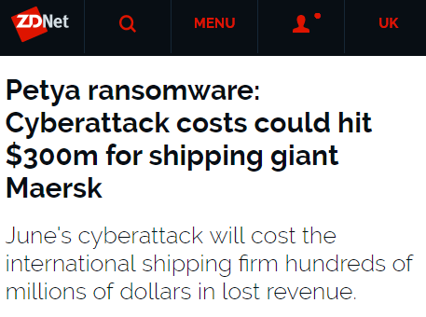
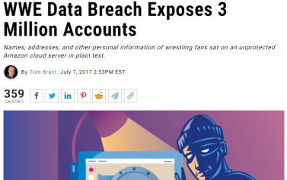
State of Cloud Cyber Security
Gizmodo.com – September 19, 2917
Lightreading.com – September 5, 2017
Scmagazine.com, September 5, 2017
And the hits just keep on coming . . .
esecurityplanet.com, September 19, 2017
ZDNet.com, August 16, 2017
pcmag.com, July 7, 2017

Slide 15
LESSONS LEARNED
The cloud is as risky to use as any other network. All normal security controls must be deployed in a cloud just as in an enterprise IT network.

Slide 16



BUCKLE UP
4 STEPS TO SECURE YOUR CLOUD

Slide 17
STEP #1: CONTROL THE CLOUD PERIMETER
Use advanced threat prevention at the cloud perimeter
Securely connect your cloud with your on-premise environment
CLOUD
ON-PREMISE

Slide 18
IS NATIVE CLOUD
SECURITY NOT ENOUGH?
©2017 Check Point Software Technologies Ltd.
18

Slide 19
Cloud = Shared Responsibility
Customer Data
Customer responsible for security in the cloud
Platform, Applications, IAM
Operating System, Network and FW Configs
Client-side Data Encryption & Data Integrity Authentication
Server-side Encryption (File System / Data)
Network Traffic Protection (Encryption, Integrity, Identity)
Cloud vendor responsible for security of the cloud
Compute
Storage
Database
Networking
Cloud Global Infrastructure
Regions
Edge Locations
Availability Zones

Slide 20
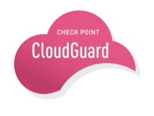
CLOUDGUARD ADVANCED PROTECTION
CLOUDGUARD PROTECTS YOUR DATA AND APPLICATIONS WITH THE INDUSTRY’S BEST THREATS CATCH-RATE
Forensic Analysis
Advanced Threat Prevention
Application and Data Security
Next Generation Firewall
Cloud Vendor
Access Rule
Notes:
Advanced protections against cyber threats – traditional on-premise solutions provide a rich set of application-level security and advanced malware protections, but similar tools are not part of the cloud security arsenal. Cloud providers utilize a shared responsibility security model – providing only one piece of the overall cloud security puzzle – leaving customers with a false sense of security for their cloud applications and data. Since corporate IT security doesn’t touch cloud services organizations, their cloud assets are vulnerable to the same security exploits and threats as their on premise assets.
https://aws.amazon.com/compliance/shared-responsibility-model/

Slide 21
LET’S LOOK AT WHAT CUSTOMERS USE TODAY
100%
NOT
PROTECTED
93%
99%
98%
50%
PROTECTED
0%
ADVANCED THREAT PREVENTION
MOBILE SECURITY
CLOUD SECURITY
Notes:
the TE usage data shows 7% for EU (764/ 11078) which is identical to the WW usage of TE.
Top countries of TE in EU for Q4 are Germany, UK and France.

Slide 22



Check Points Closes the Gaps
Multi-Layered Security for All Networks
IPS, ANTIVIRUS & ANTI-BOT
Catches known or old malware
Of known malware, 71 in 1000 are not caught
OS- AND CPU-LEVEL ZERO-DAY PROTECTION
Detects new and unknown malware
With both OS and CPU level prevention
THREAT EXTRACTION
Complete threat removal
Reconstruct malware-free documents
Notes:
Presentation Outline
d. What is our position? (We believe in multi layered protection) – a Multi-layered security strategy is vital to preventing malware infections.
In the face of this vulnerability you may ask what our position is…wonderful question.
We believe a multi-layered security strategy is vital to preventing malware infections.
This multi-layered strategy separates malware into known and unknown and uses layers to protect against both.
In the known space IPS, AV & AB use signatures to catch malware that is known to the world
In the unknown arena to protect against zero day and unknown malware a two stage emulation strategy identifies & blocks exploits at the cpu level and vulnerabilities at the OS level
To cap this strategy, and complete the protection, Extraction reconstructs documents to ensure they are malware free.
Source:
1- Kaspersky Labs Virus Bulletin (www.virusbtn.com) – October 2014

Slide 23
STEP #2: SECURE THE CLOUD FROM THE INSIDE
Micro-segment your cloud to control inside communication
Prevent lateral threats movement between applications
App
App
App
App
Notes:
Perimeter security can not:
Prevent infection movement between applications
Provide visibility inside the datacenter

Slide 24

FROM PERIMETER SECURITY TO APPLICATION SECURITY
1. Perimeter Security doesn’t secure the data center from internal threats
App
App
App
App
App
App
App
App
App
3. Traditional static security fails to protect the dynamic data center
2. 80% of data center traffic between applications is invisible
App
App
App
App
App
App

Slide 25
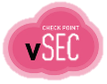
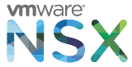


SECURITY INSIDE YOUR CLOUD
Securing the datacenter from the inside is now simple with SDN
Micro segment the datacenter with advanced protection between applications
App
App
App
App
CISCO ACI

Slide 26
DEMO
©2017 Check Point Software Technologies Ltd.
26

Slide 27



STEP #3: MANAGE CONSISTENT SECURITY FOR HYBRID ENVIRONMENTS
Deploy unified security management for your hybrid cloud (On-Premise and Cloud)
Ensure policy consistency
Reduce operation cost
CLOUD
ON-PREMISE
Notes:
Visibility into all traffic and threats – with more and more data extending beyond traditional corporate control, businesses are increasingly challenged to get a clear view of the workloads running in cloud environments, including any threats and other malicious activity that could be introduced and/or affecting their data residing in the cloud. What’s more, assets tagged or grouped in the cloud may not directly translate to corporate security schemas, leaving security teams guessing as to the exact extent of their attack surface and hampering their ability to mitigate risk.
Security management and enforcement – as security controls are now shared with virtual networks and cloud providers, organizations struggle to maintain a consistent security posture for their extended application workloads and data. The tools and technology used to manage legacy corporate security are quite different than the tools and technology employed by cloud providers, resulting in a lack of consistent security policies and enforcement.
Logging and reporting – toggling between multiple, disparate solutions makes getting a clear picture of network traffic and threat activity extremely difficult, especially as data and workloads migrate away from IT controlled equipment. Audits and compliance reporting are equally challenging as businesses and cloud providers utilize different tools, maintain and secure logs in different manners, and provide varying degrees of access controls for administration and reporting

Slide 28
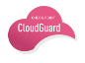
Hybrid Cloud Security Architecture with CLOUDGUARD
WWW
Azure
On Premise Datacenter
AWS
vNET-1
Transit
VPC
vNET-2
SDN
VPC-1
VPC-2
VPC-3
Check Point Unified Management & Security Policy

Slide 29



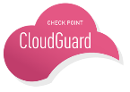
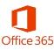


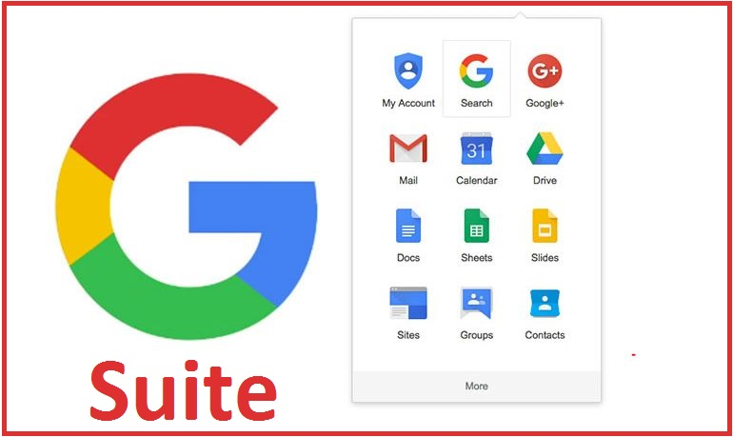



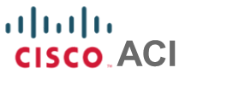


COMPREHENSIVE SECURITY ARCHITECTURE
Headquarters
Remote Employees
Branch
Private Cloud & SDN
Public IAAS
SAAS
Notes:
Check Point CloudGuard is comprehensive portfolio of products designed to bring our industry-leading advanced threat prevention security to protect assets in private clouds, public cloud – IaaS environments and now also to SaaS-based applications.

Slide 30
DEMO
©2017 Check Point Software Technologies Ltd.
30

Slide 31



STEP #4: AUTOMATE YOUR SECURITY
Security must be as elastic and dynamic as your cloud
Auto-provisioned
Auto-scaled
Adaptive to changes

Slide 32

Traditional Approach Not Designed for Cloud
Static controls
Manually intensive
Silo’d disciplines
Lack of knowledge / expertise among DevOps
Lack of cloud knowledge/experience from IT security teams

Slide 33

Security Automation & Orchestration
Security at the speed of DevOps
Adapt policy to application changes
Auto-scale security with Pay-as-you-Go
Auto-provisioning via templates and APIs

Slide 34
CLOUD SECURITY MUST BE ADAPTIVE
 | Legacy Security | Cloud Security
Adding new application | Add rule is a SHOWSTOPPER | Adaptive policy is an ENABLER
Security inside the cloud | Network change is COMPLEX | SDN integration is AUTOMATIC
Application growth | Replacing appliances is EXPENSIVE | Auto-Scale is EFFORTLESS

Slide 35



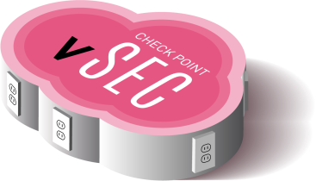


ADAPTIVE SECURITY
Reduce Firewall Tickets by 60%
Check Point Access Policy
Rule | From | To | Application | Action
3 | Finance_App1 (vCenter Object) | Database_Group (NSX SecGroup) | MSSQL | Allow
4 | HR_App2 (Azure Object) | Finance_Group (ACI EndPoint Group) | CRM | Allow
5 | User_ID | SAP_App (AWS Object) | SAP | Allow

Slide 36
DEMO
©2017 Check Point Software Technologies Ltd.
36

Slide 37


DevOps
MISSION: BUSINESS AGILITY & PRODUCTIVITY
Joint team of developers & operations
Ownership of the entire applications lifecycle (Security incl.)
Automated provisioning of applications, networks & security controls
Using self service portals & APIs
Auto-deployment with templates
Auto-scale according to need
Easy to control with CLI and to integrate with REST API
Smart policy using cloud objects

Slide 38

CHECK POINT’S CLOUD SECURITY BLUEPRINT
Agile - security architecture that enables DevOps innovation
Efficient – automatically deploy, provision & scale your security in the Cloud
Multi-Clouds – unified security architecture for all environments
https://www.checkpoint.com/downloads/product-related/check-point-secure-cloud-blueprint.pdf
Notes:
Our blueprint shows the recommended security architecture for deployment on public cloud.
North and South Hubs (only entry points to the environment) are owned/managed by Network / Security departments, the rest are managed by the application owner and by that allow better agility.
Elasticity and efficiency are achieved by extracting the security to an external hubs and by that the network can be flexible with the number spokes per the needs without impacting the security.
Traffic leaving a the spokes is always inspected by the firewalls in the south-hub

Slide 39


CHECK POINT’S CLOUD SECURITY BLUEPRINT
Cloud Virtual Environment
Northbound-HUB
North Bound Security is Auto-Scaled
Load Balancer
vSEC Auto-Scale
…..
vSEC-1
vSEC-N
Southbound Security is highly available
Supported Clouds
Azure Transit- vNET
AWS Transit - VPC
WWW
SPOKE-1
Load Balancer
SPOKE-2
Load Balancer
SPOKE-3
…
SPOKE-N
Southbound-HUB
vSEC Cluster
VPN
vSEC-1
vSEC-2
Notes:
Check Point blueprint for public cloud is based on a Hub and spokes architectures. While the security management is unified to all gateways from a single server.
we utilize 2 hubs within the environment, this enables flexibility and systematic separation of communication types through the environment.
It includes 3 tiers:
North-HUB, this hub is designated for incoming / outgoing traffic with the Internet. we will deploy protection for the internet connectivity, it can deployed as Auto-scaling gateways or any other supported deployment method.
Spokes, the spokes might contain several virtual servers that comprise application stack (web, application and database) or acts as an extension of existing on premise network, depend on the company needs.
South-HUB, this hub is designated for lateral traffic between spokes and the connectivity with the on-premise. In this hub we will handle all of the lateral communication between the spokes.

Slide 40
DEMO
©2017 Check Point Software Technologies Ltd.
40

Slide 41


Summary
1. Comprehensive Security Protections Advanced Threat Prevention for cloud data and workloads
2. Automated Operations Provisioning tied to Cloud Management Platforms
3. Dynamic Policies
Consistent management for Physical and Virtual Infrastructures
4. Centralized Management Single pane-of-glass experience across premise and all clouds

Slide 42

STAND 9
Notes:
Sacrificing speed and agility for security
Lateral spread of threats
Security concerns associated with moving data beyond traditional IT controls keep many organizations from fully embracing the cloud. Businesses want the ability to control their own data and keep it private all while maintaining compliance with regulatory mandates.
Advanced protections against cyber threats – traditional on-premise solutions provide a rich set of application-level security and advanced malware protections, but similar tools are not part of the cloud security arsenal. Cloud providers utilize a shared responsibility security model – providing only one piece of the overall cloud security puzzle – leaving customers with a false sense of security for their cloud applications and data. Since corporate IT security doesn’t touch cloud services organizations, their cloud assets are vulnerable to the same security exploits and threats as their on premise assets.
Visibility into all traffic and threats – with more and more data extending beyond traditional corporate control, businesses are increasingly challenged to get a clear view of the workloads running in cloud environments, including any threats and other malicious activity that could be introduced and/or affecting their data residing in the cloud. What’s more, assets tagged or grouped in the cloud may not directly translate to corporate security schemas, leaving security teams guessing as to the exact extent of their attack surface and hampering their ability to mitigate risk.
Security management and enforcement – as security controls are now shared with virtual networks and cloud providers, organizations struggle to maintain a consistent security posture for their extended application workloads and data. The tools and technology used to manage legacy corporate security are quite different than the tools and technology employed by cloud providers, resulting in a lack of consistent security policies and enforcement.
Logging and reporting – toggling between multiple, disparate solutions makes getting a clear picture of network traffic and threat activity extremely difficult, especially as data and workloads migrate away from IT controlled equipment. Audits and compliance reporting are equally challenging as businesses and cloud providers utilize different tools, maintain and secure logs in different manners, and provide varying degrees of access controls for administration and reporting

Slide 43
